Slide 1

Murang’a University of Technology Innovation for Prosperity
Online Voter Registration and Voting System
Presented by Ndegwa Victor Mugo
SC200/5064/2018
Supervised by Madam Millicent and Dr. Njenga S.

Slide 2
Presentation Outline
Introduction
Problem Statement and objective
Literature review
Coding Details and efficiency
Project Time-plan
Research methodology
System Implementation
Testing and Results conclusion
Proposed Budget

Slide 3
Introduction
Voter registration in this country has been a hectic process based on lots of paperwork and missing data.
As result many prospective voters do not register.
The voting process is also done manually and long queues have to be made by people who could be attending other businesses.

Slide 4
Problem statement and objective
Lots of resources and time is spent by the commission, hiring registration clerks who traverse through the various parts of a Constituency over a period of time, about a month. The prospective voters also have to look for those registration clerks within office hours, which might inconvenience them since they might also be working or in school.
To develop a web-based platform for prospective voters to register as voters in the IEBC and provide all the data required is the main objective of this project. This system will ease time taken in search of registration venue and the registration clerks, including time wasted waiting on the queue to be served.

Slide 5
Literature review
This outlines the currently existing voter registration process, the customized software that is used, the logistics involved in the whole process, the data submission levels and other various government registration platforms, especially those that are online.
The components of the BVR, which is the current software were also procured from the same company, for easy integration into the software and compatibility without any further configurations.

Slide 6
Research methodology
Research methodology is a chapter of a research that describes research methods, approaches and designs in detail highlighting those used throughout the study, justifying the choice made through describing advantages and disadvantages of each approach and design taking into account their practical applicability to the research. This chapter outlines research design, population and sampling, data collection and materials, system development methodology, system design and data processing
Systems design is the process of defining elements of a system like modules, architecture, components and their interfaces and data for a system based on the specified requirements. It is the process of defining, developing and designing systems which satisfies the specific needs and requirements of a business or organization.

Slide 7
Research methodology
Construction phase
The Construct phase refers to production of the actual software product at every spiral. In the baseline spiral, when the product was justified thought of and the design was developed in this phase to get customer( applicants)feedback.
Evaluation and risk analysis
Risk Analysis includes identifying, estimating and monitoring the technical feasibility and management risks, such as schedule slippage and cost overrun. After testing the build, at the end of first iteration, the applicant evaluated the software and provided positive recommendation feedback.

Slide 8
Code Details and Efficiency
JavaScript and HTML code have been integrated into PHP files where they fall on the same webpage for code efficiency.
AJAX framework has bee used to optimize and seamlessly connect the frontend to the backend.

Slide 9
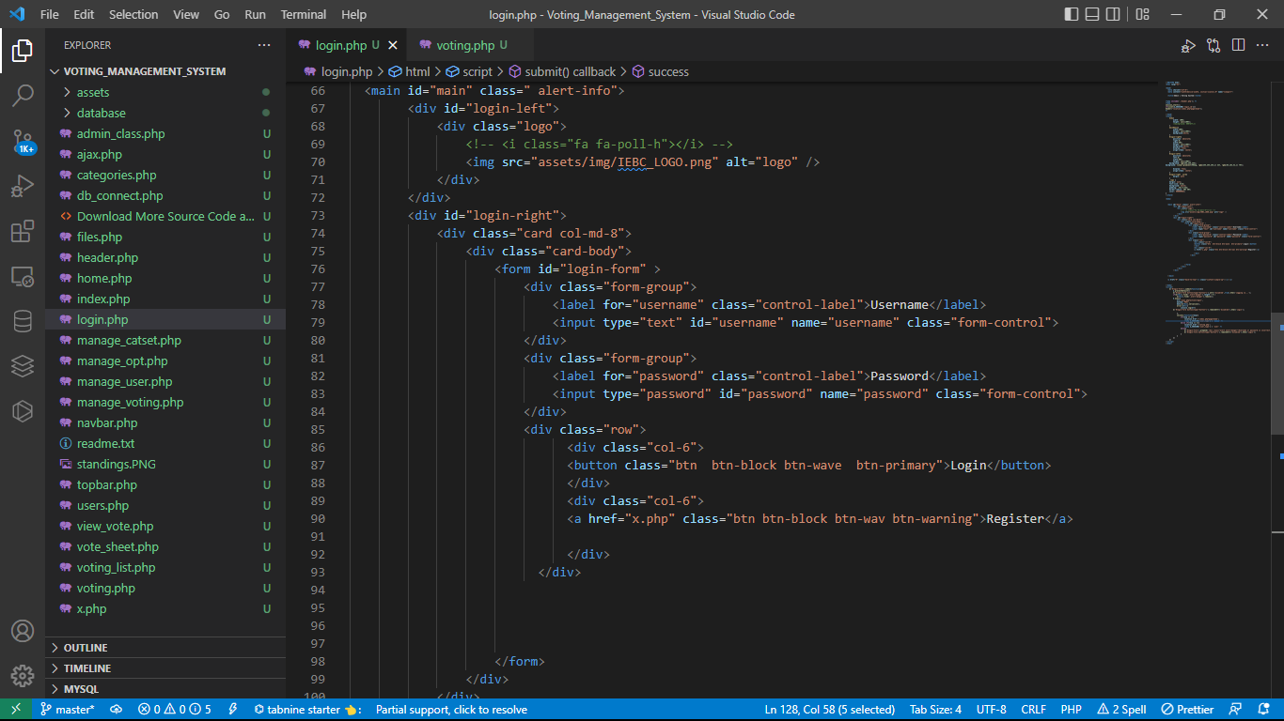
Code Details and Efficiency
Code for login and signup

Slide 10
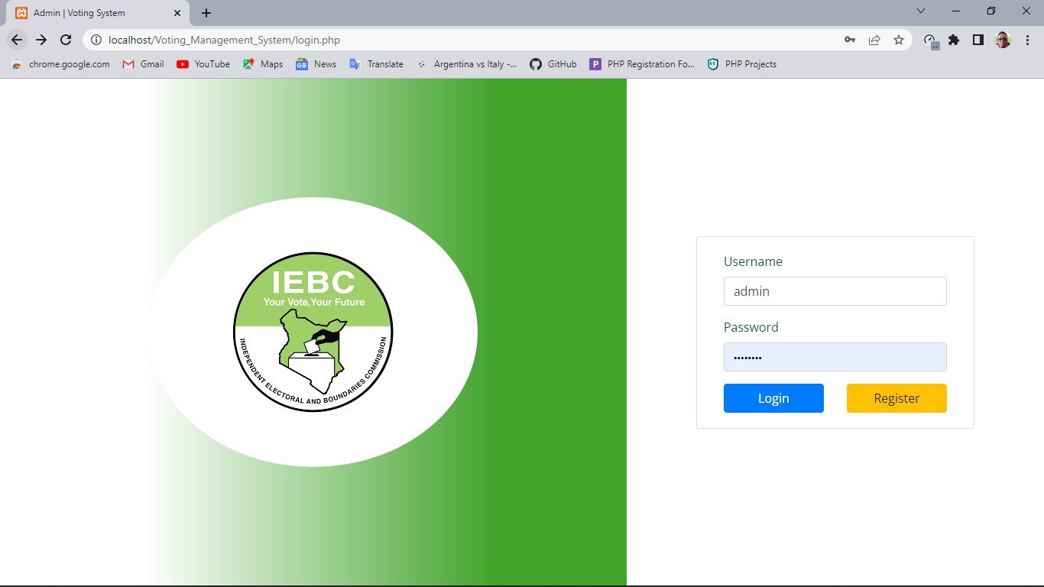
Code Details and Efficiency
login and signup interface

Slide 11
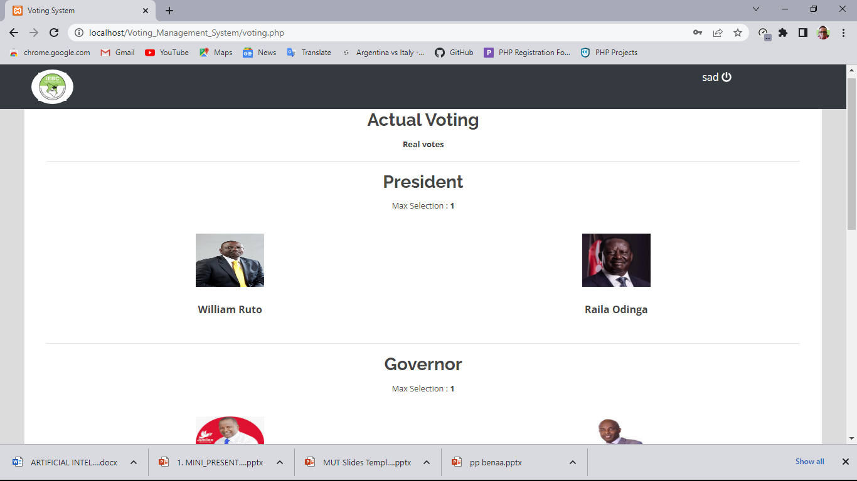
Presentation Outline
Actual voting page

Slide 12
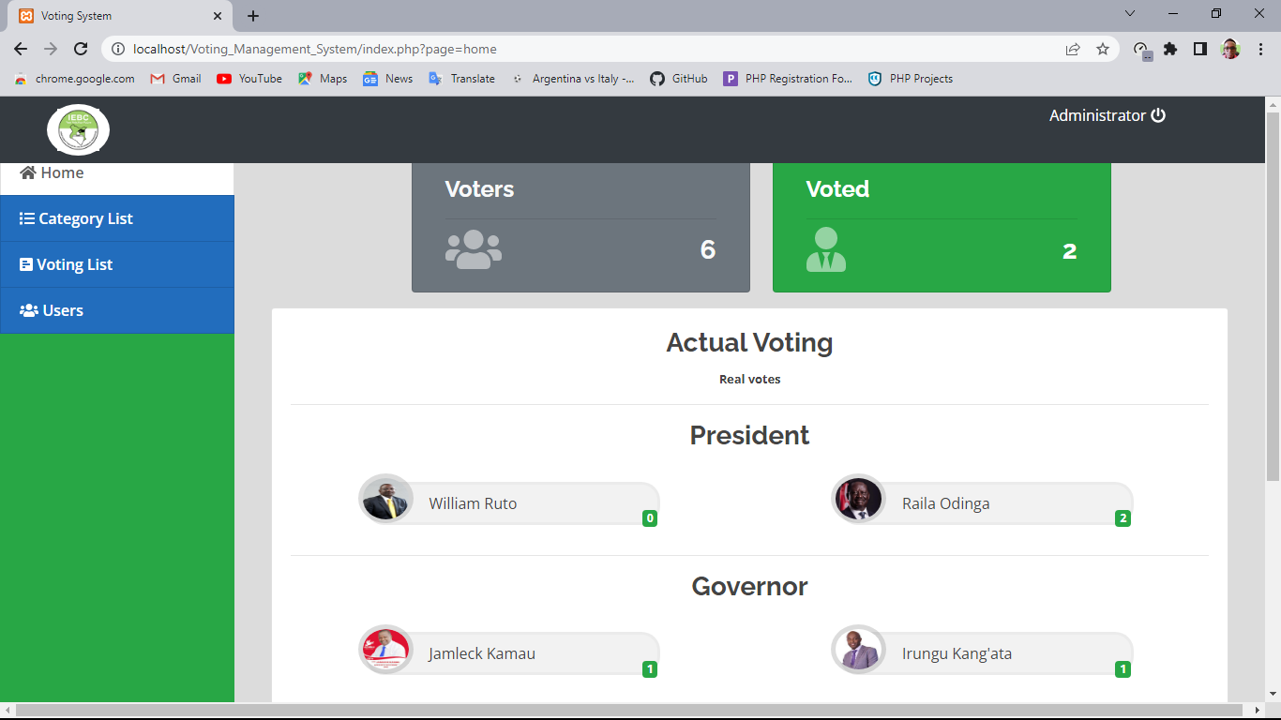
Presentation Outline
Admin voter tally report page

Slide 13
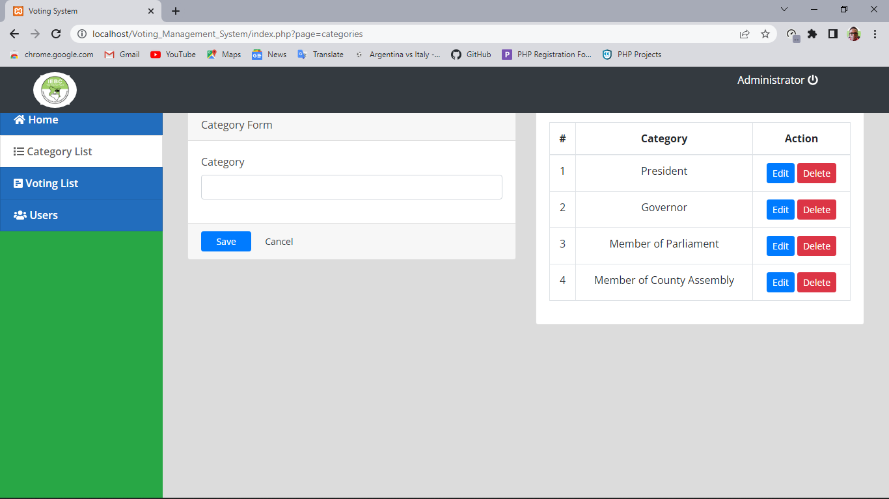
Presentation Outline
Admin category control page

Slide 14
Summary of the findings
The findings of the research show that indeed there are many disadvantages with the current approach used to register new voters, which would be solved with the functionalities of this system. For instance;
The lengthy paperwork required currently by the IEBC in voter registration which is quite tedious. It is not necessary to subject these people to such processes notwithstanding the fact that time is a very delicate factor in this process. The proposed system only requires you to provide your details and then you can start voting immediately from your mobile phone or computer.
Once a voter does vote using their account, they cannot vote again using the same account.

Slide 15
Conclusion and recommendation.
The system has reasonable short time response. The voter can login or sign up is able to get response for his request in 2-4 seconds which is robust compared to earlier system. All the password that are generated or accepted is stored in database in an encrypted compared to existing system where it may be stored as it is thus vulnerable to attacks. Successful application is done only if user uploads correct filled form and the administration checks for details to verify whether the applicant is qualified to be a registered voter or not. In voting and tallying the system is reliable, providing high performance. To prevent data loss in case of system failure, the filled form is saved in the database waiting for approval or for future refences.

Slide 16
THE END
THANK YOU ALL.

